Slide 1
Weekly report: Electrical Drivetrain
Week number: 3
Date: 07/10/2025
Supervisor: Prof. Dr.-Ing. Saiju
Group members: Aiswarya Vijayan, Vishranti Shivajirao Patil , Girish Mahadeo Padalkar, Cristina Milene Vergara Hernandez
Presented By : Girish Padalkar

Slide 2
List of contents
DFIG Working Principle
Converter Rating
Local Partner & Market Strategy
Physical and Cost Parameters
Conclusion & Next Steps
Presented By : Girish Padalkar
Electrical Drive Train/ Optimus Syria

Slide 3
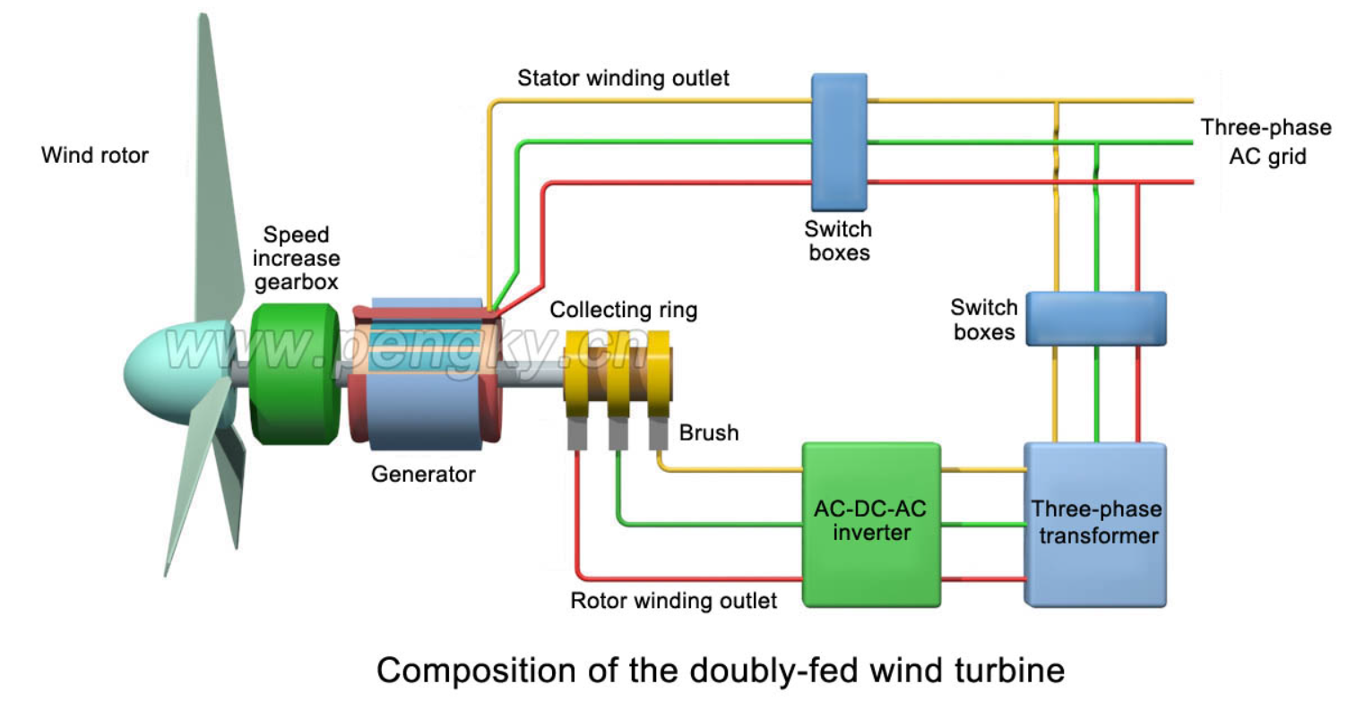
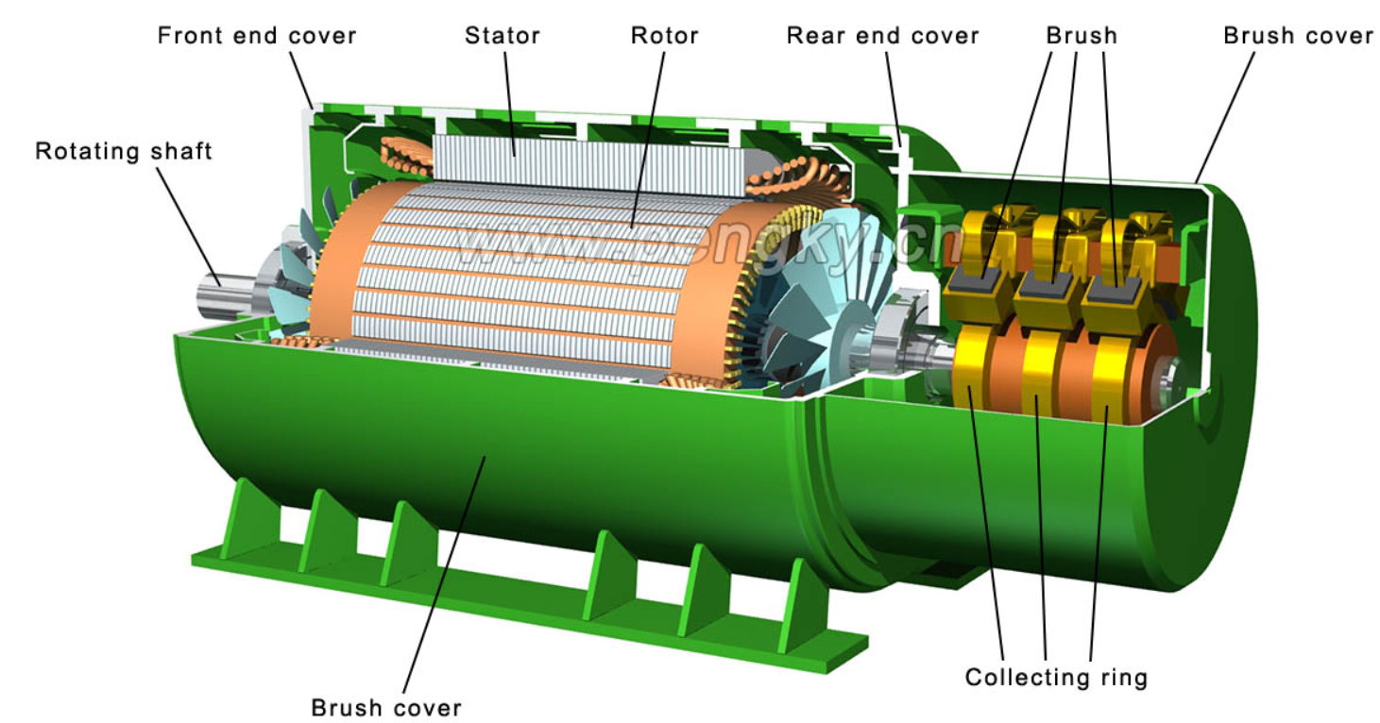
1. DFIG Working Principle
Rotor connected via slip rings to partial converter
Stator directly connected to grid
Enables variable-speed operation
Power flow
Active Power : Supplied via stator and rotor.
Reactive Power : Controlled by rotor-side converter.
Bidirectional flow : Converter enables flexible grid support.
[2]
[1]
Presented By : Girish Padalkar

Slide 4
2. Converter Rating
Partial converter : ~25 -30% of generator capacity.
For 5MW DFIG : ~1.2 MW to 1.5 MW .
Lower cost and losses vs. full-scale converters.
Physical Parameters (5MW DFIG )
Parameter | Value/Range
Outer Diameter (Stator) | 2.0 – 2.5 m
Axial length | 2.0 – 2.5 m
Air Gap length | 1.0- 3.0 m
Rotational speed | 1,500 – 2,000 rpm
Generator mass | 20 – 30 tons
Presented By : Girish Padalkar

Slide 5
3. Local Partner & Market Strategy
Manufacturer / Supplier | Relevant Model / Platform | Generator Type (DFIG) | Approx. Generator Weight (Component Only) | Estimated | Manufacturer / Supplier
WDRVM (Syria) | 3.X MW to 10.X MW Platforms | Geared DFIG / PMSG | N/A (Local Assembly) | Negotiable (Local Content Priority) | Initial priority for local content and support specific to Syrian grid.
Siemens Gamesa | SG 5.0-145 (2.0) Onshore | Geared DFIG | 20 to 30 Tons | $1.2 M to $1.6 M | Confirmed commercial 5.0 MW product, acts as primary European technical benchmark.
SANY | SI-16050 SE16050 (5.0 MW) | Geared DFIG | 20 to 30 Tons | $1.0 M to $1.3 M | High-volume Asian supplier; provides aggressive cost and delivery benchmark.
GE Vernova | 4.8 MW to 6.1 MW Platforms | DFIG | 20 to 30 Tons | $1.2 M to $1.6 M | Active development in this capacity range, offering competitive U.S./Global technology.
ABB / WEG | Components Only | Standalone DFIG / PMSG | 20 to 30 Tons | N/A (Component Cost) | Critical component suppliers for local WDRVM assembly or repair/maintenance.
Presented By : Girish Padalkar

Slide 6
4. Physical and Cost Parameter
Generator Specifications (Estimated for a 5 MW Geared DFIG)
Table below: Specific dimensions and air gap are proprietary data. The figures below are typical industry estimates for a high-speed, geared DFIG rated at 5 MW (50 Hz grid).
Parameter | Estimated Value / Range | Unit | Implication for Project
Rated Power | 5,000 | kW | Project Requirement
Rated Voltage | 690 | V | Standard low-voltage output for large turbines (steps up via transformer).
Maximum Speed | 1,500 to 2,000 | rpm | Requires high-ratio gearbox (typically 1:80 to 1:100).
Air Gap Length | 1.0 to 3.0 | mm | Critical for efficiency and magnetic coupling. Small air gap minimizes reactive power needs.
Outer Diameter (Stator) | 2.0 to 2.5 | m | Determines nacelle size and logistical requirements.
Axial Length (L) | 2.0 to 2.5 | m | Compact size relative to Direct Drive generators.
Generator Mass (Weight) | 20,000 to 30,000 | kg (20 to 30 Tons) | Lighter than PMSG, reducing tower top load and crane requirements.
[2]
Presented By : Girish Padalkar

Slide 7
4. Physical and Cost Parameter
Total Installed Wind Farm Cost: USD 1,800 to USD 2,200/kW (Onshore).
5 MW Farm Cost: ∼USD 9 Million to USD 11 Million (Total project).
Turbine System (Generator + Nacelle + Rotor): Typically, 65% to 75% of the total farm cost.
Generator & Converter System Cost: Estimated at 15% to 20% of the total Turbine System Cost.
Cost Item | Estimated Range | Notes
DFIG Generator Unit (5 MW) | USD 550,000 to USD 800,000 | Estimate for the generator machine only.
Power Converter (2 MW Rated) | USD 600,000 to USD 900,000 | Estimate for the back-to-back converter system (partial rating).
Total DFIG Electrical Drive | USD 1.15 Million to USD 1.7 Million | This cost advantage is why DFIG is popular in the 5 MW range.
Presented By : Girish Padalkar

Slide 8
5. Next Step
Planning:
align our milestone planning with the other teams
Technical:
Generator: more detailed estimation of dimensions (size & rotational speed), Cost.
Converter: first research and collect the data of converter.
Presented By : Girish Padalkar

Slide 9
Bibliography
text{https://en.wind-turbine-models.com/turbines/2465-sany-si-16050-se16050} [1]
https://www.pengky.cn/zz-horizontal-axis-turbine/13-doubly-fed-wind-turbine-principle/doubly-fed-wind-turbine-principle.html [2]
https://www.siemensgamesa.com/global/en/home/products-and-services/onshore/wind-turbine-sg-5-0-145.html
DFIG Market Status and Reliability: Is Using DFIG in Wind Turbines an Obsolete Technology? (Industry Article)
DFIG Product Offering (ABB): ABB Doubly-fed Generators
DFIG Turbine Platform (Siemens Gamesa): Siemens Gamesa SG 5.0-145 (2.0) Wind Turbine
Presented By : Girish Padalkar

